Slide 1
ML systems and pipelines
MLOps [-] AutoML
Yabebal Fantaye (PhD)

Slide 2
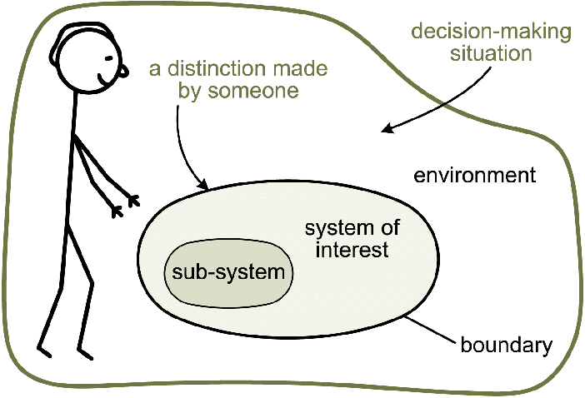
System thinking
Systems thinking is a holistic approach to analysis that focuses on the way that a system's constituent parts interrelate and how systems work over time and within the context of larger systems.

Slide 3
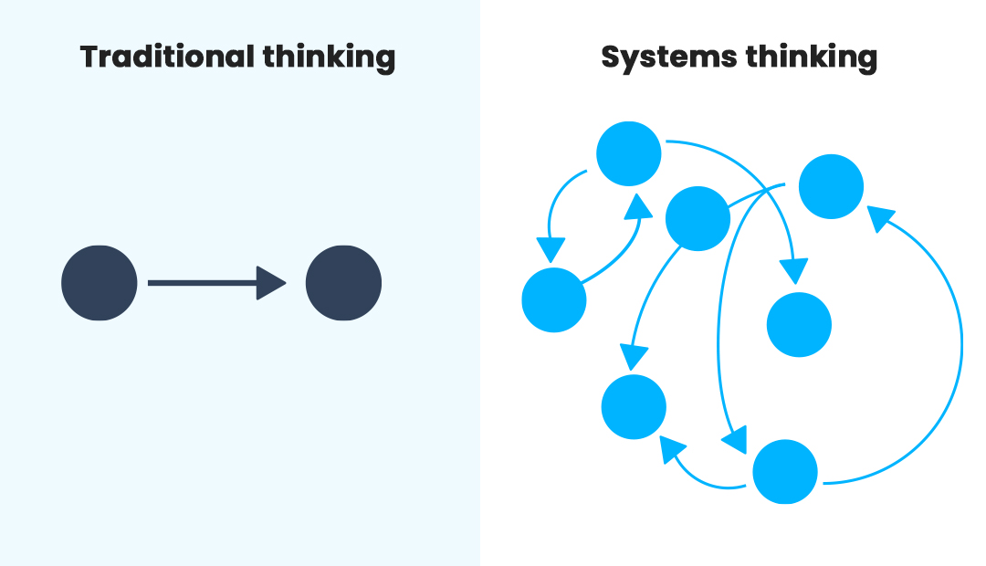

Slide 4
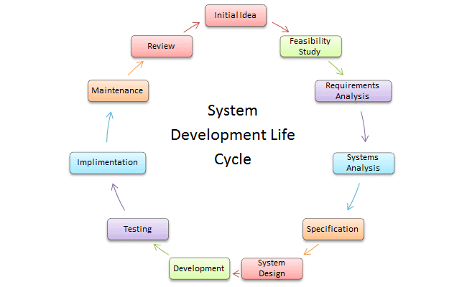

Slide 5
Process, workflow, pipeline
A structured approach to planning a project.
Tasks - a piece of work to be done within a defined period of time and has a pre-defined outcome.
Process - a set of tasks that are chained in simple or complex ways. Introduces task parallelism.
Workflow - a general relationship of processes that improves the efficiency. Introduces process parallelism.
Pipeline - a set of workflows. Introduces workflow parallelism.

Slide 6
Workflow
A workflow down a continuous process into a set of manageable categories such that the over all tasks that needs to be done to achieve the desired objectives are
Easy to automate
Easy to manage
Repeatable across different situations
Resource (time, money, etc.) waste is minimized
Agile - easy to adapt for new changes in the process pipeline
Easy to scale
Improves communication
Delivers high quality outcome at the shortest time possible

Slide 7
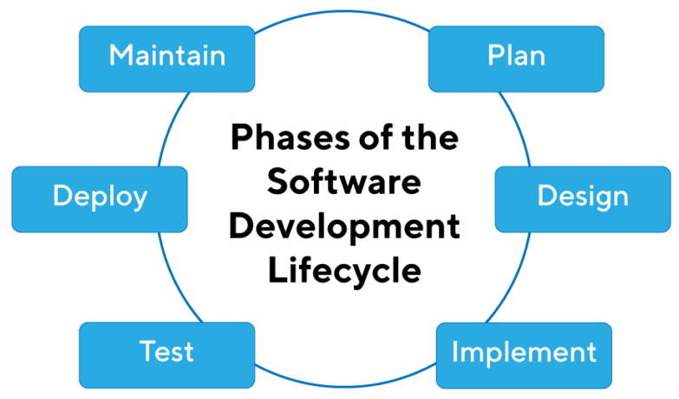
Structured Development (Dev)
Software Development Life Cycle is the application of standard business practices to building software applications. It's typically divided into six to eight steps: Planning, Requirements, Design, Build, Document, Test, Deploy, Maintain

Slide 8
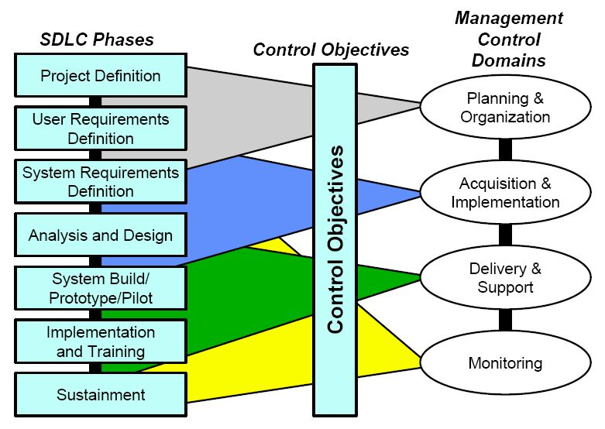
Management and control
Each development needs to have control layer as well to set objectives, add capacity, and monitor progress.

Slide 9
Structured Operations (Ops)
Operations teams are infrastructure and process owners for the organizations.
System level operations apply a similar principle to development cycles but with different outcomes - ensuring minimum system interruption and frictionless operation.
Moreover, DevOps means operation team is responsible for
Enabling self-service for teams
Standardized tooling and processes across the business.
Bringing extensible automation to traditional operations tasks
Working and shipping like developers.

Slide 10
DevOps
The following are the known benefits of DevOps principle
Shortens the development cycles
Increases deployment velocity
Dependable production releases.
These benefits are better achieved by utilising two concepts in the software system development:
Continuous Integration (CI)
Continuous Delivery (CD)

Slide 11
MLOps & AutoML
Main references for this section are:
practitioners_guide_to_mlops_whitepaper.pdf (google.com)
MLOps: Continuous delivery and automation pipelines in machine learning (google.com)

Slide 12
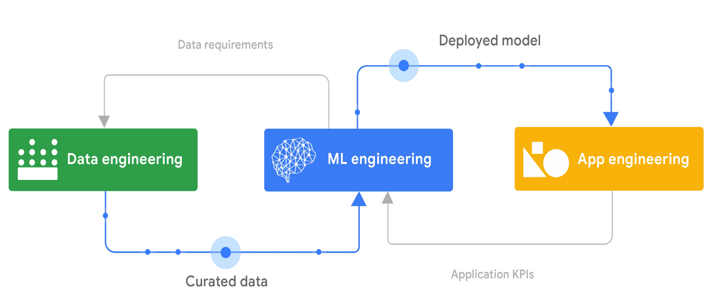
ML System

Slide 13
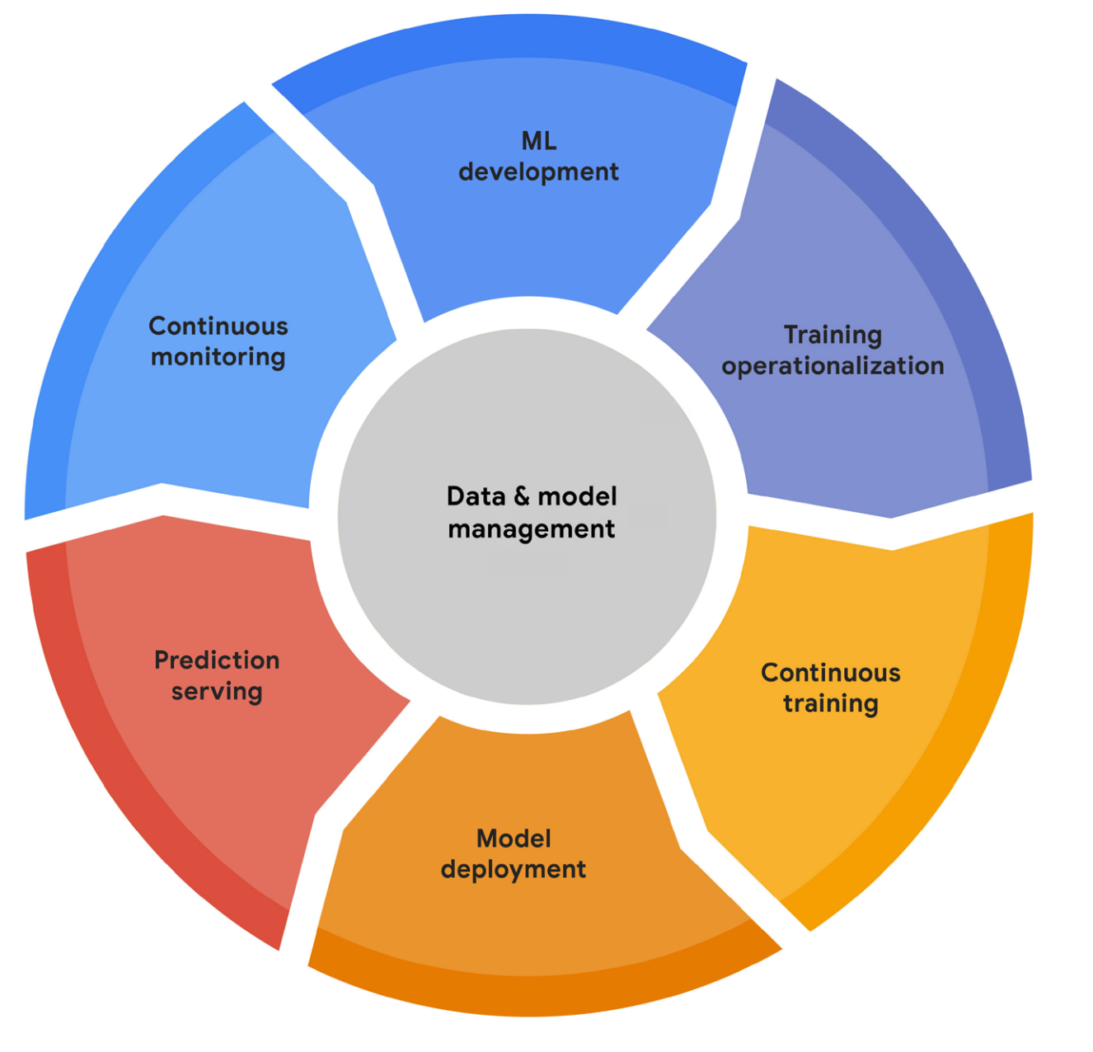
MLOps
It is DevOps principles applied to Machine Learning Systems

Slide 14
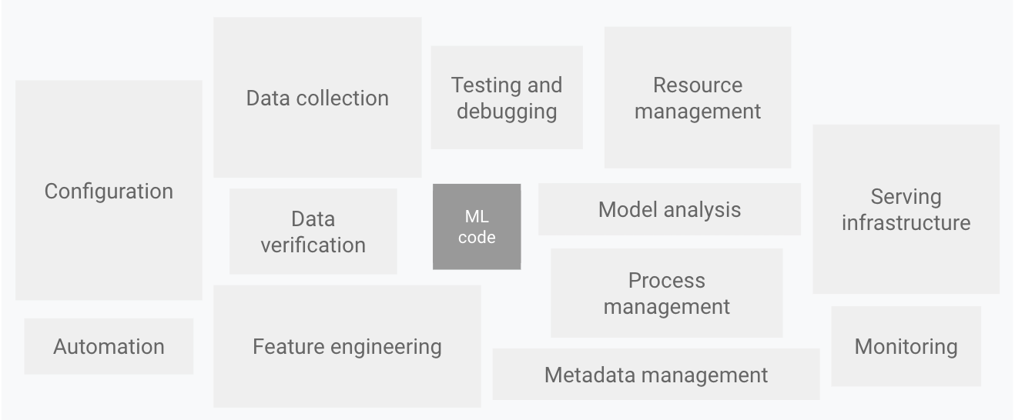
MLOps Components

Slide 15
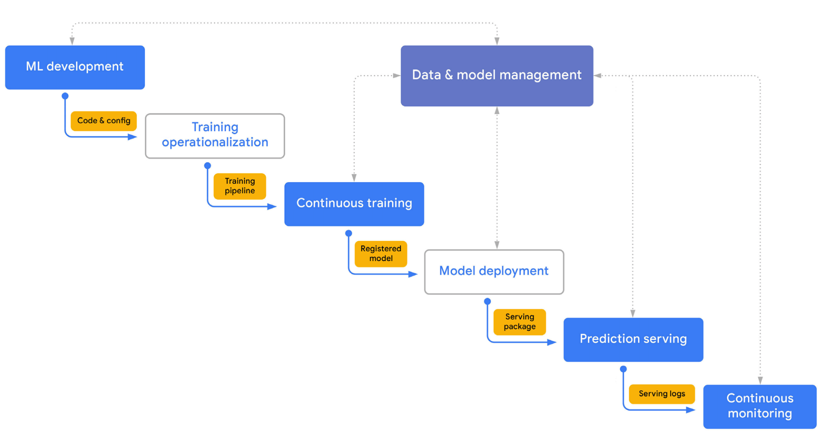
MLOps Workflow

Slide 16
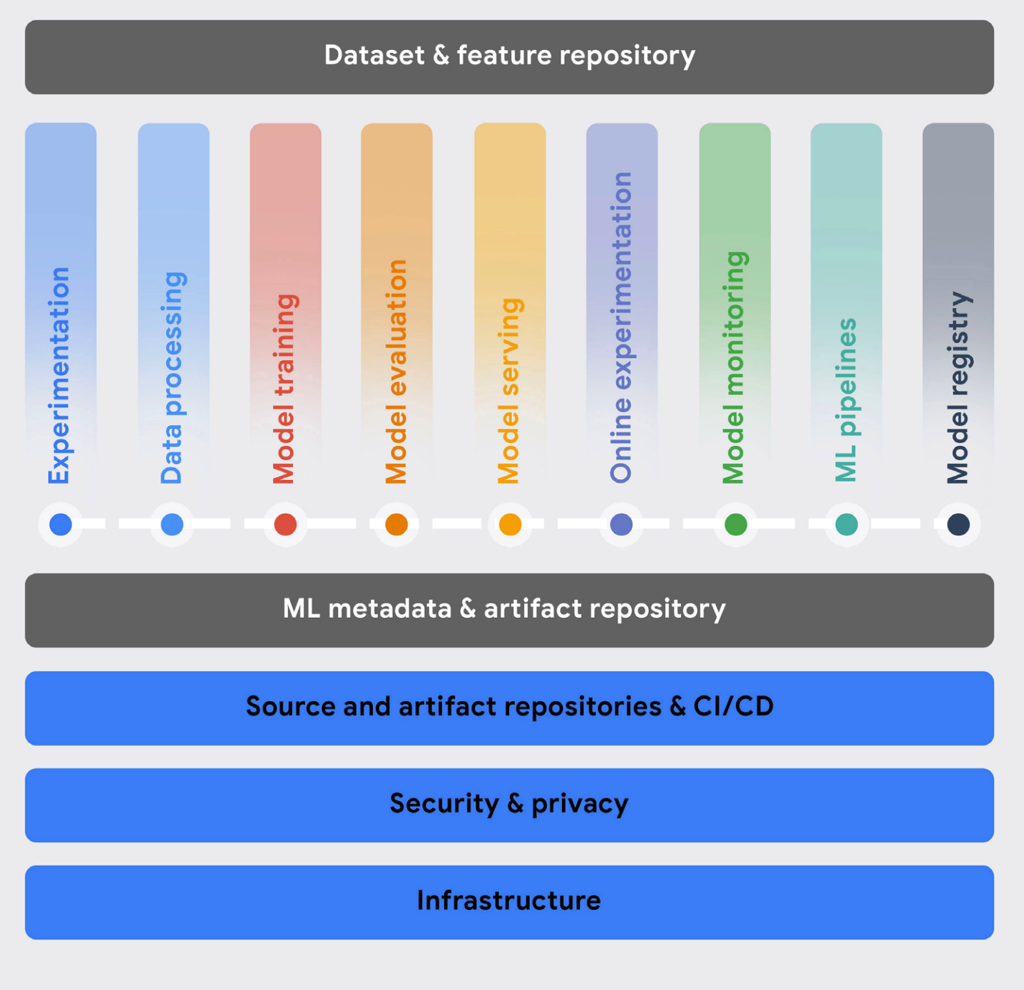
MLOps Capabilities
The fundamental capabilities are:
a reliable, scalable, and secure storage and compute infrastructure

Slide 17
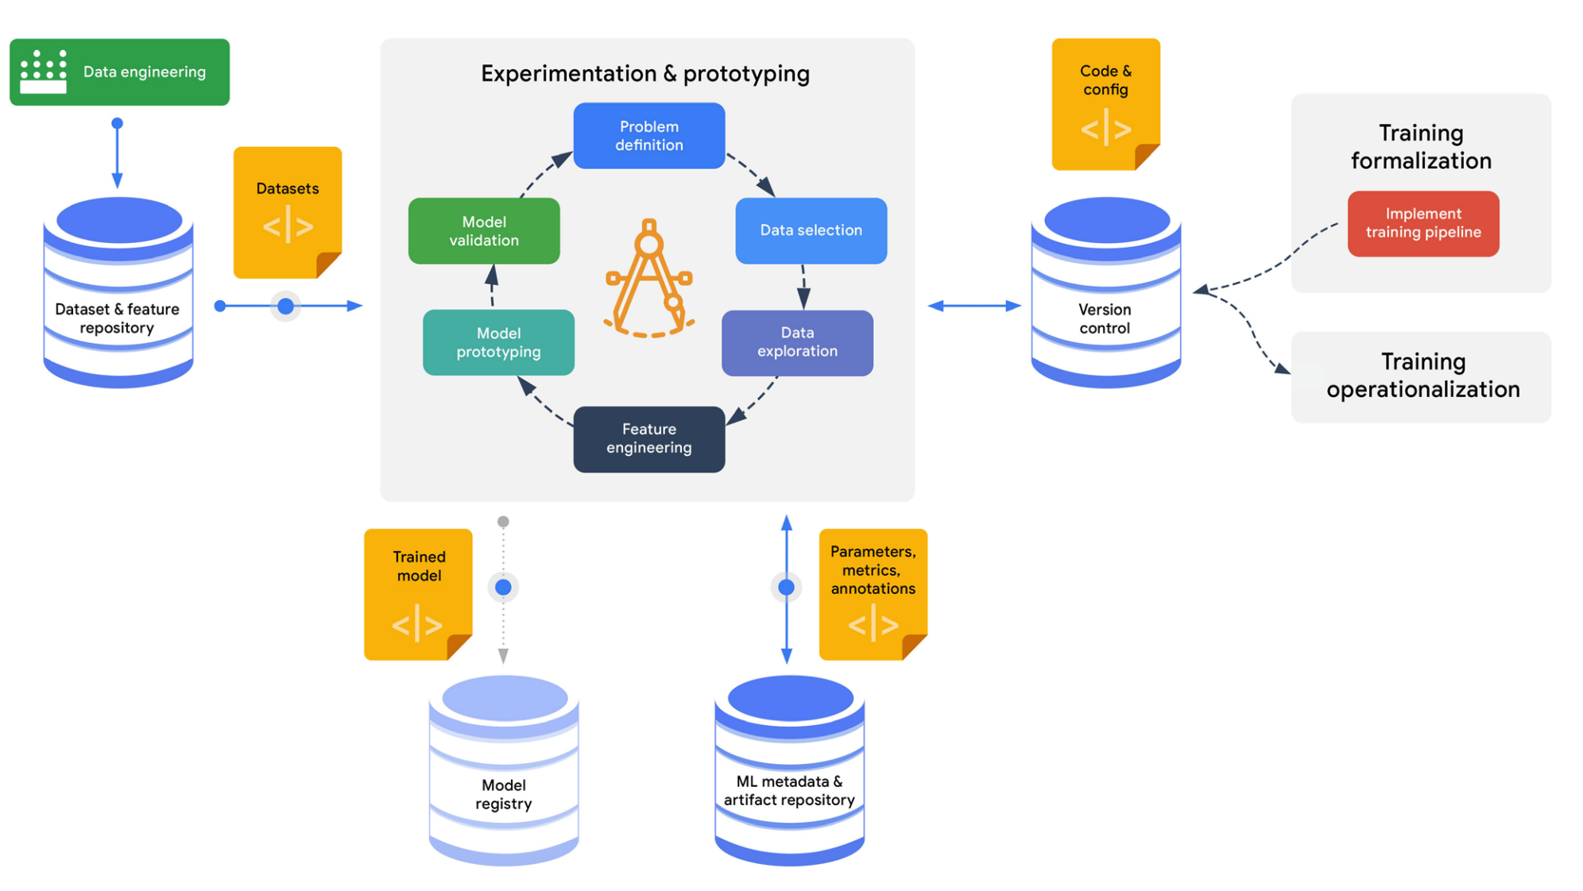
ML Development Process

Slide 18
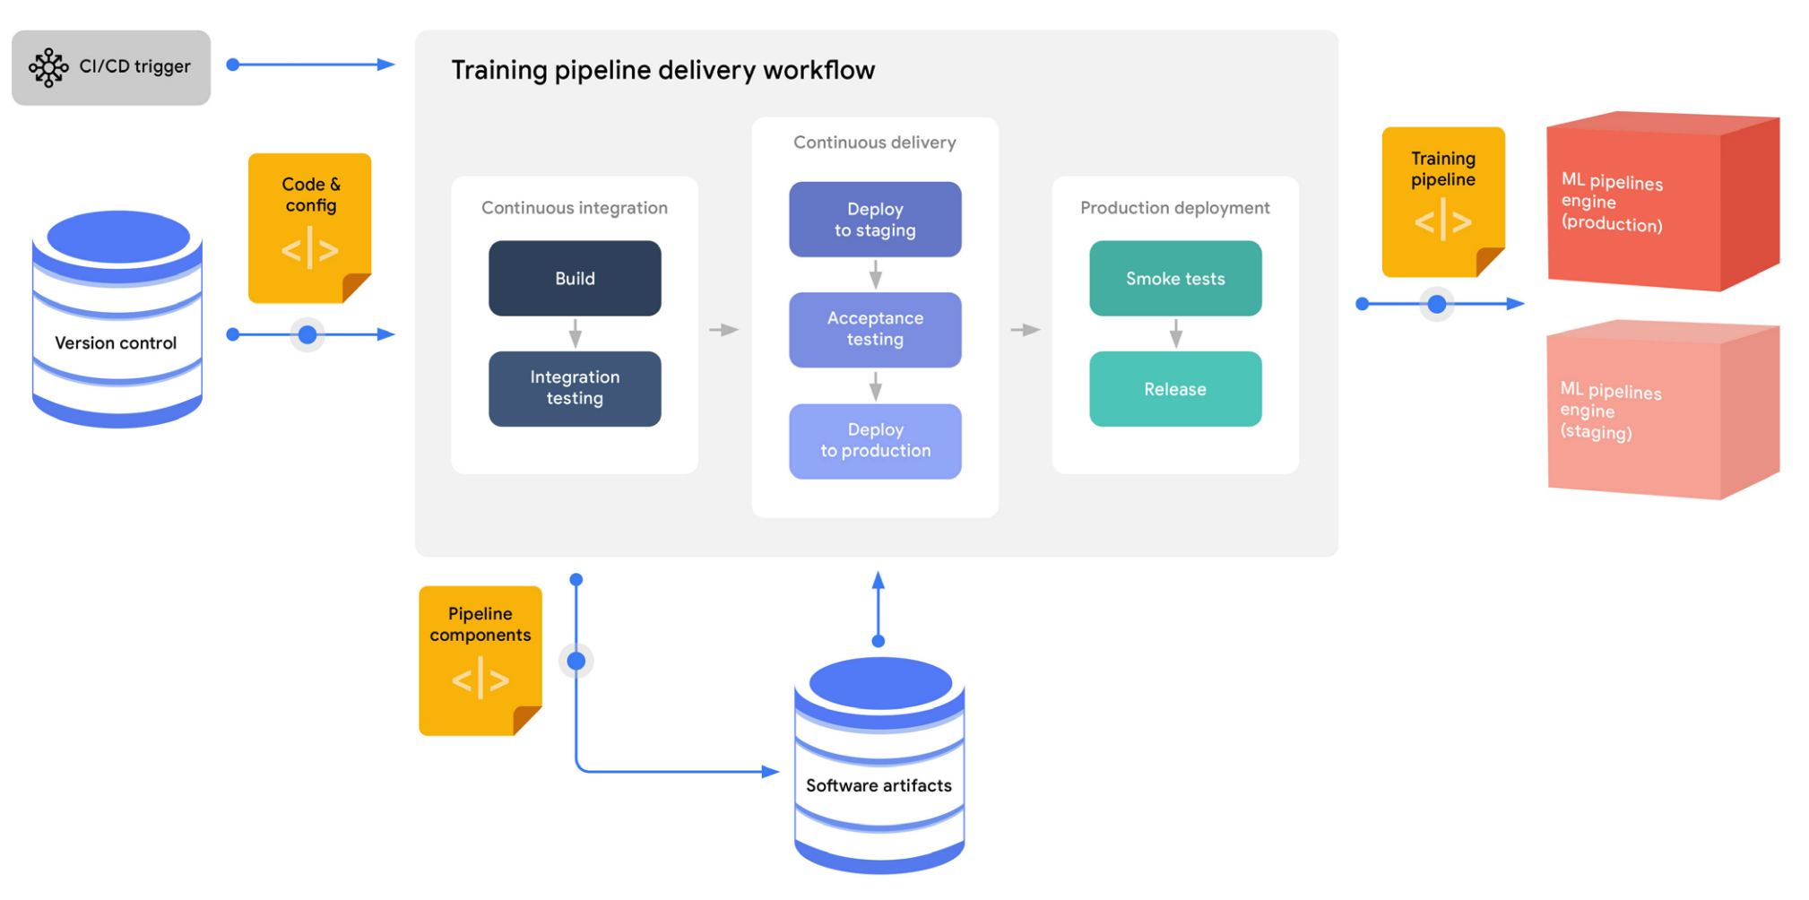
Training Operations

Slide 19
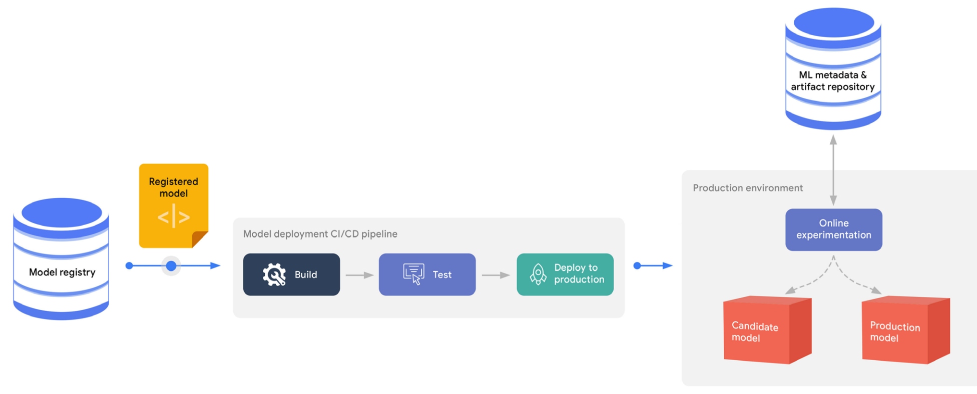
Deployment Process

Slide 20
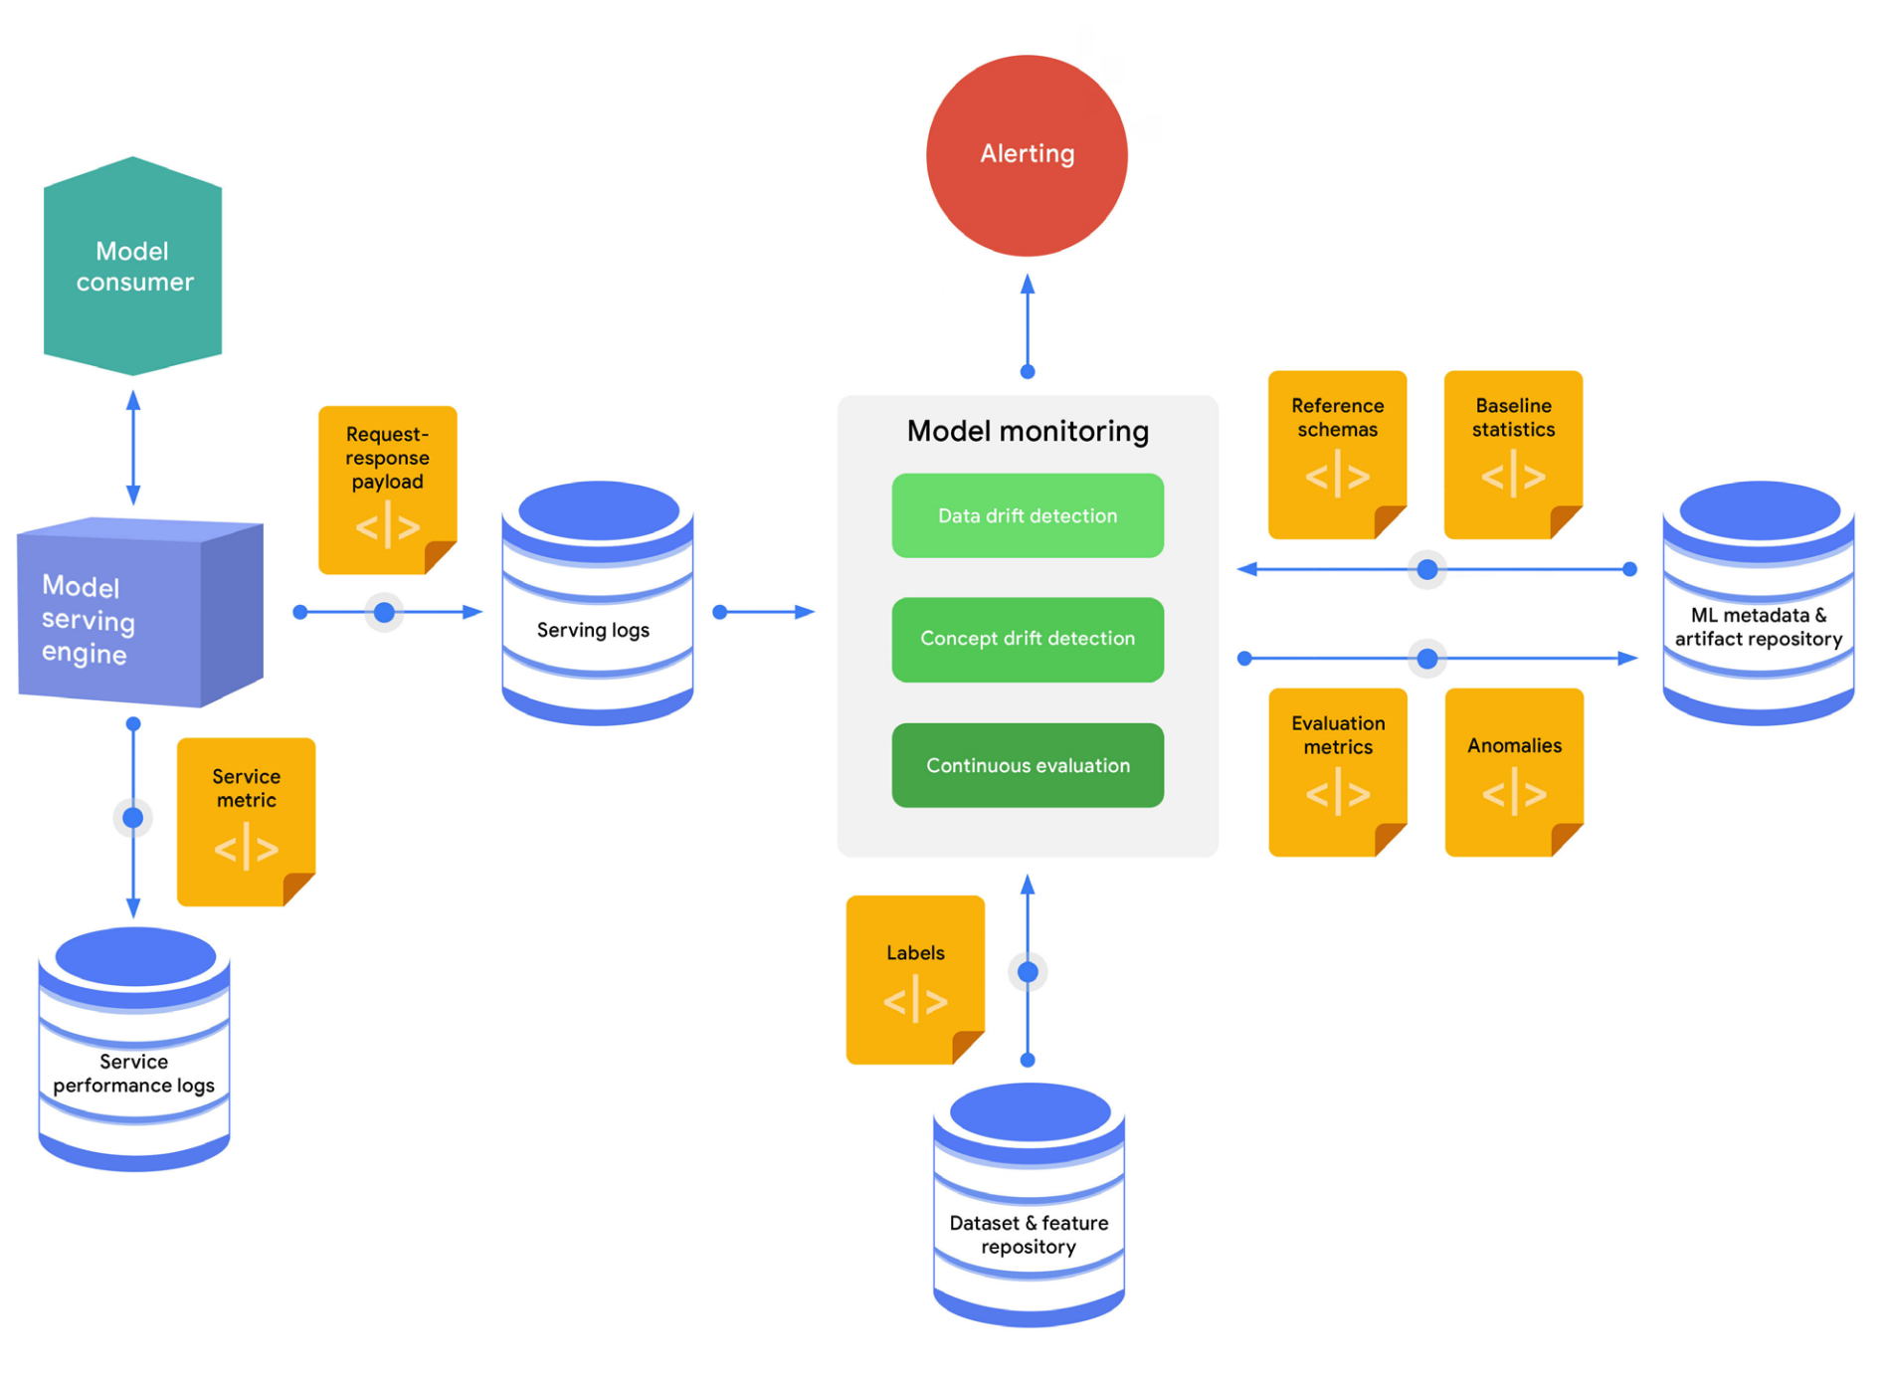
Monitoring engine

Slide 21
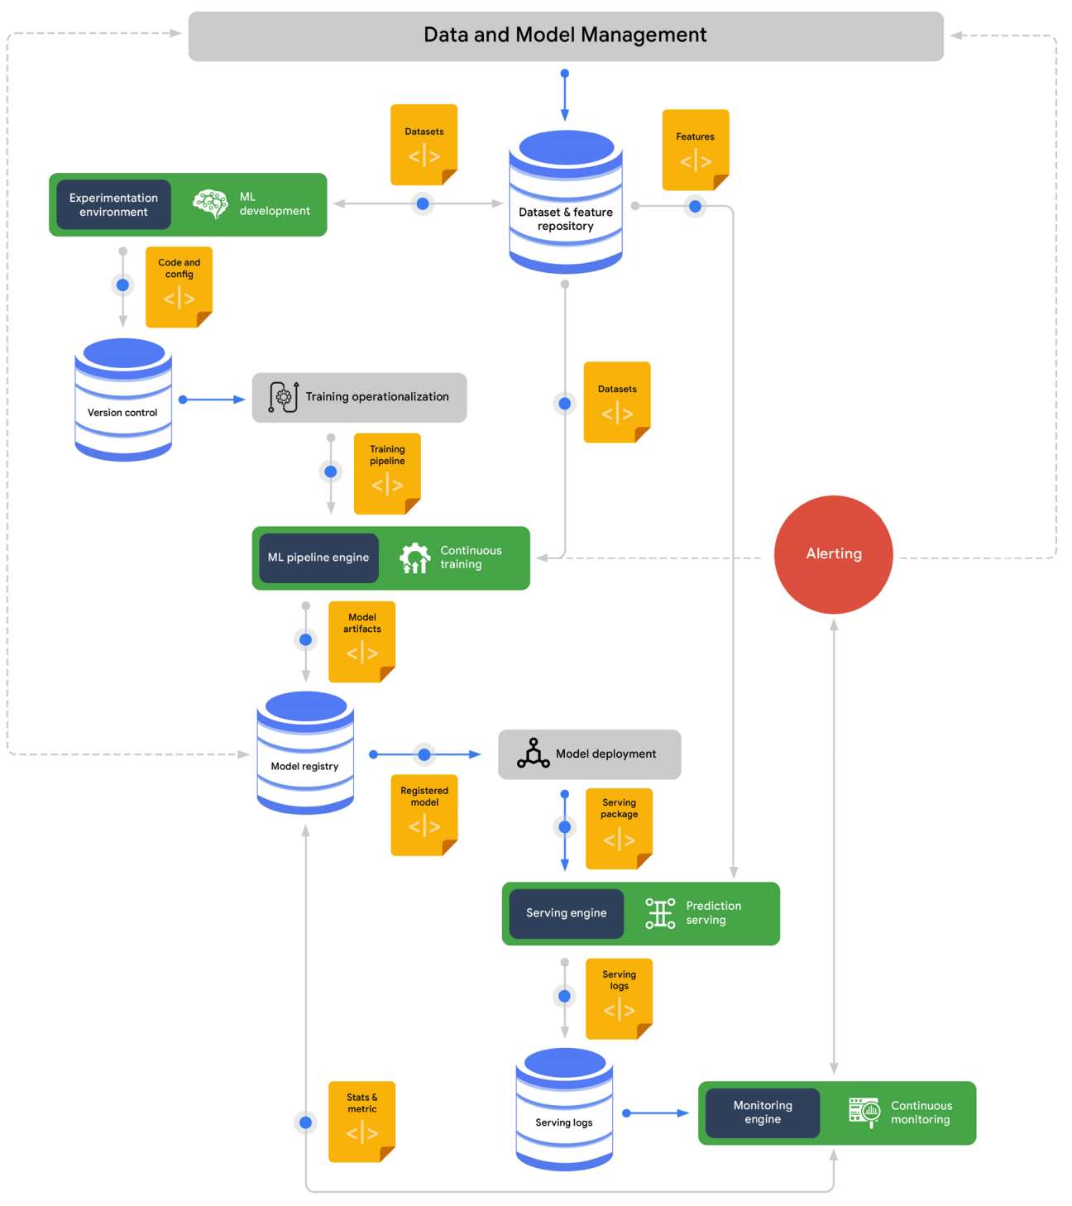
MLOps End-to-End
Training operationalization: concerns automating the process of packaging, testing, and deploying repeatable and reliable training pipelines. •
Continuous training: concerns repeatedly executing the training pipeline in response to new data or to code changes, or on a schedule, potentially with new training settings.
Model deployment: concerns packaging, testing, and deploying a model to a serving environment for online experimentation and production serving.
Prediction serving: is about serving the model that is deployed in production for inference.
Continuous monitoring: is about monitoring the effectiveness and efficiency of a deployed model.
Data and model management: governs ML artifacts to support shareability, reusability, discoverability auditability, traceability, and compliance of ML assets

Slide 22
References
What is operations in DevOps? The evolving role of Operations in DevOps (github.blog)
MLOps: Continuous delivery and automation pipelines in machine learning (google.com)

